Slide 1
ME 476C Prototyping Summary
Renewable Energy Project
Michael Horn, Garrett Cornelius, Nicholis Santana & Issac Granados

Slide 2
Prototyping
Renewable Energy Lab Solar Panel Testing
Old array deconstructed
New solar panels installed, wired, and tested successfully
Inverter is receiving enough power to test functionality
Introduced Grid Power to system
Simulating system install, set-up, and usage modes
Main Goal : Gain “Hands-on” experience

Slide 3
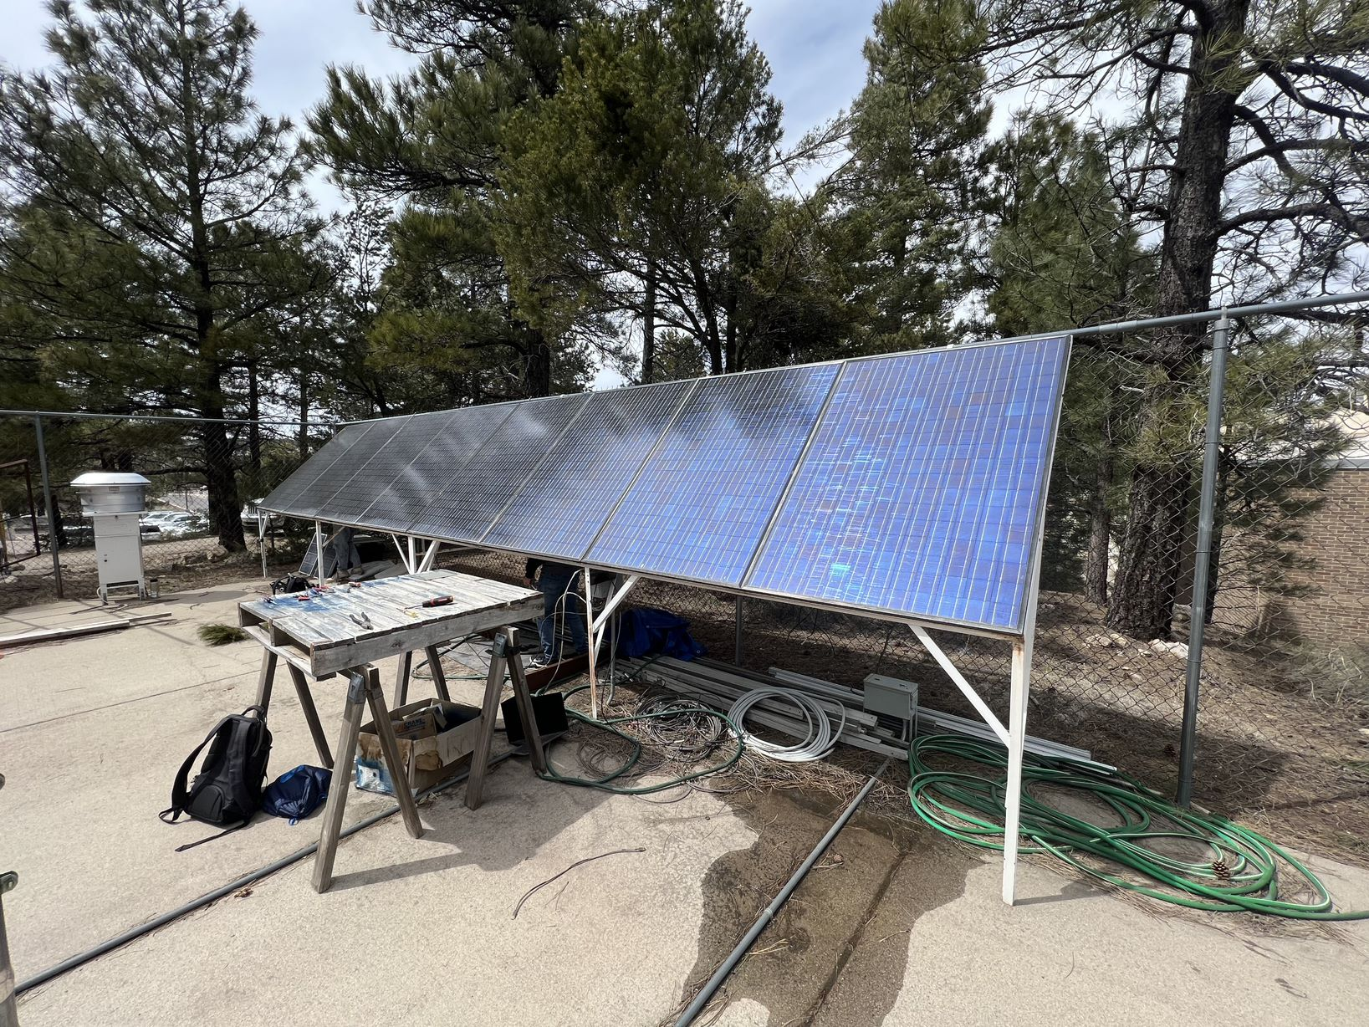
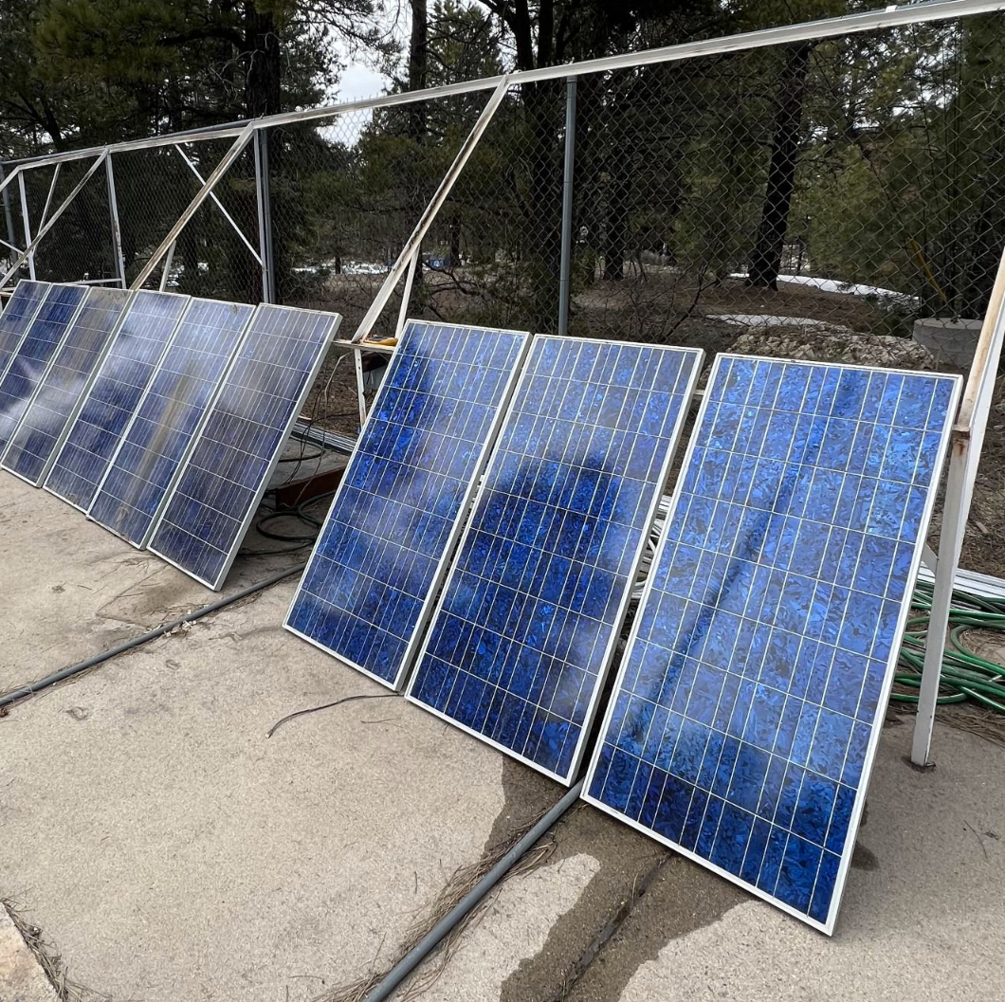
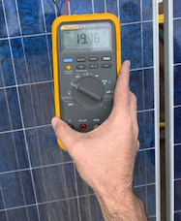
Prototyping Photos
Figure 1: Old Panel Array
Figure 2: New Panel Array
Figure 3: New Array Voltage

Slide 4
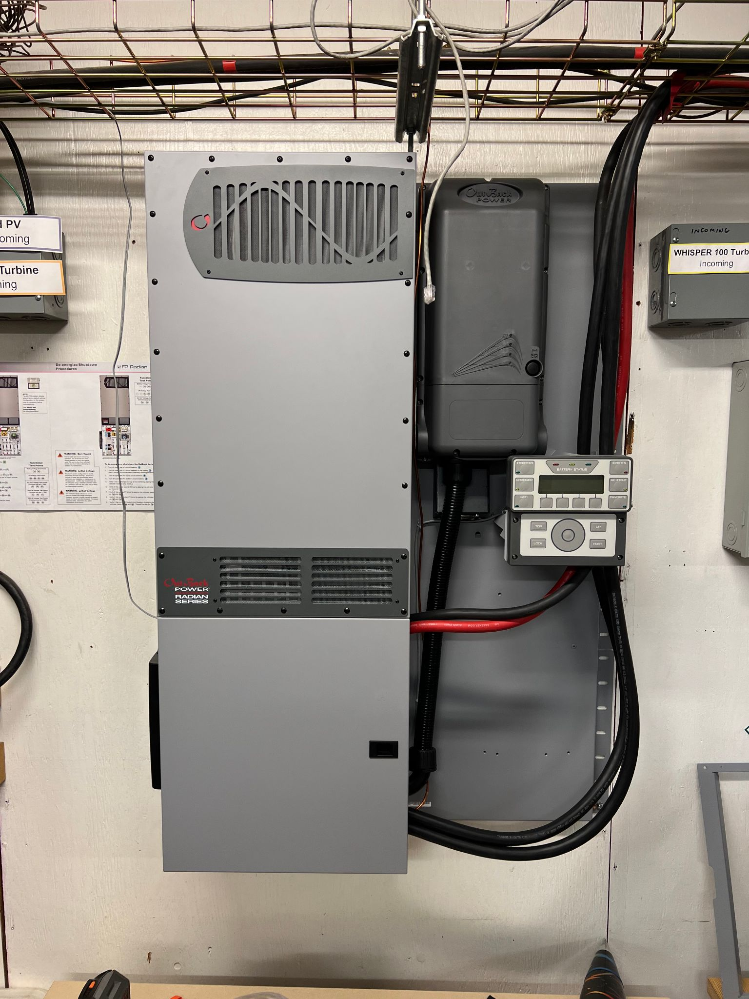
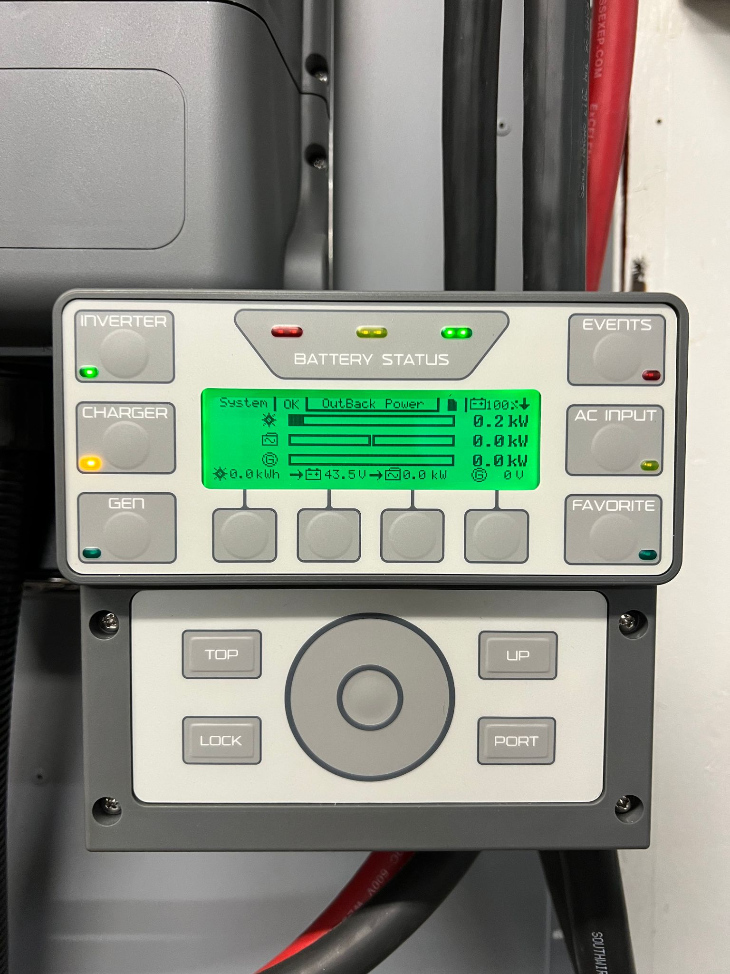
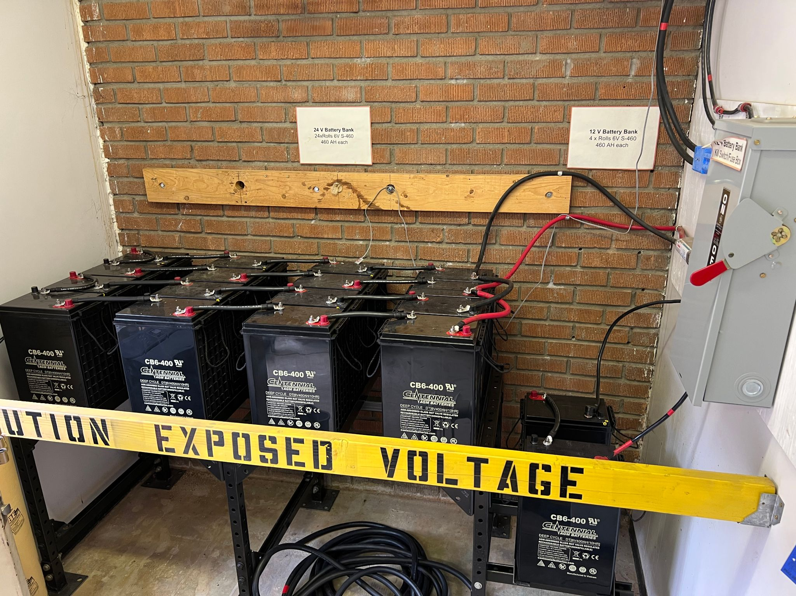
Prototyping Photos
Figure 4: Inverter System
Figure 5: System Monitor
Figure 6: Battery Bank System

Slide 5
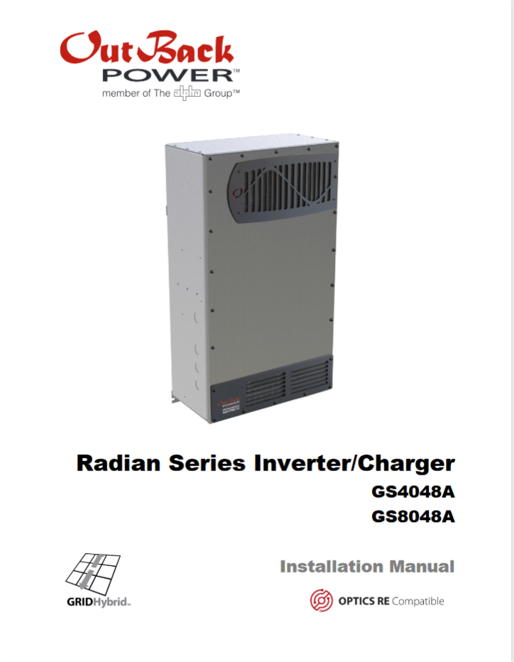
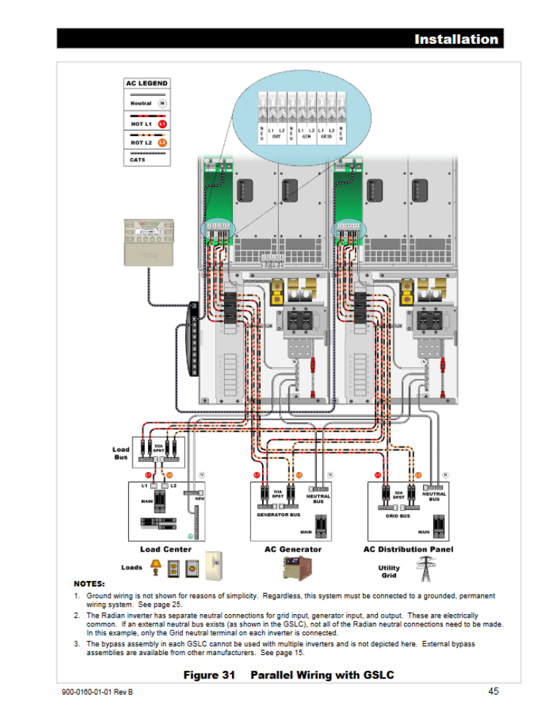
Inverter Installation Manual
Figure 7: Inverter System
Figure 8: Inverter System
Figure 7 and 8 Reference [1] : “Radian series inverter/charger.”

Slide 6
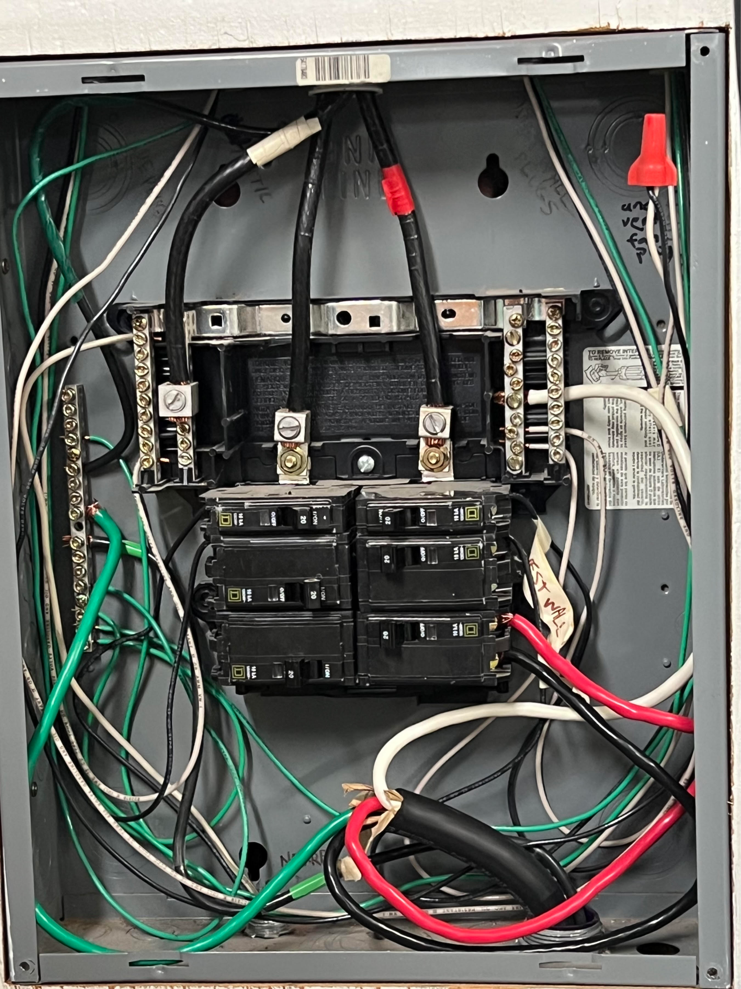
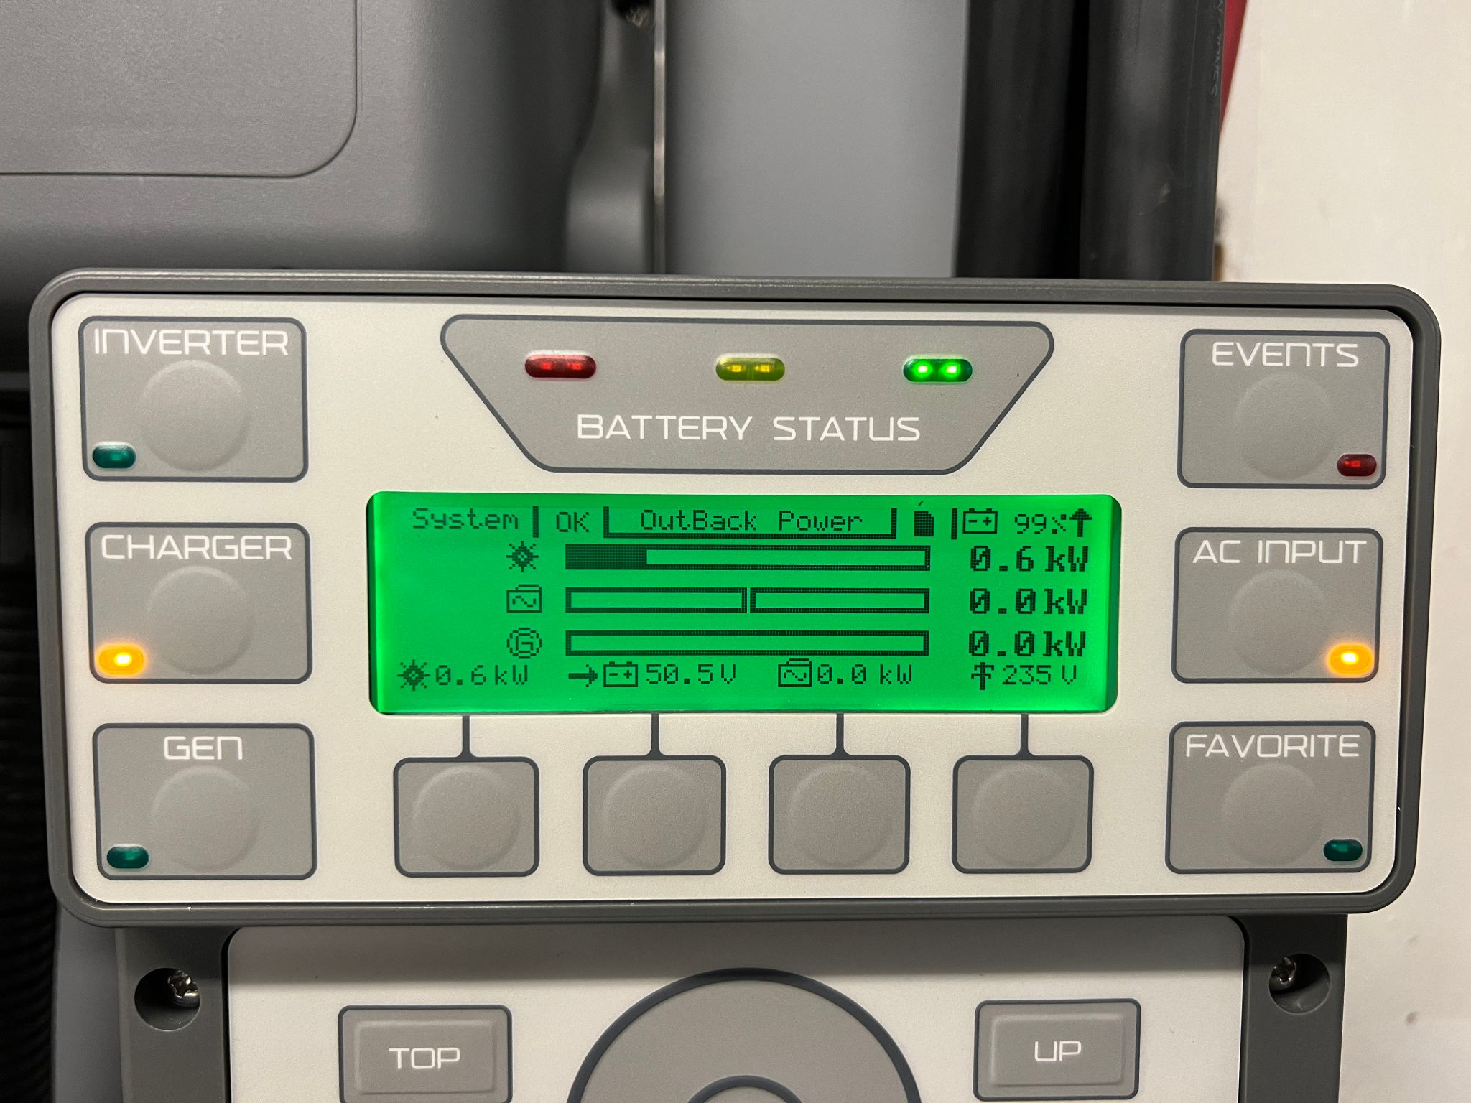
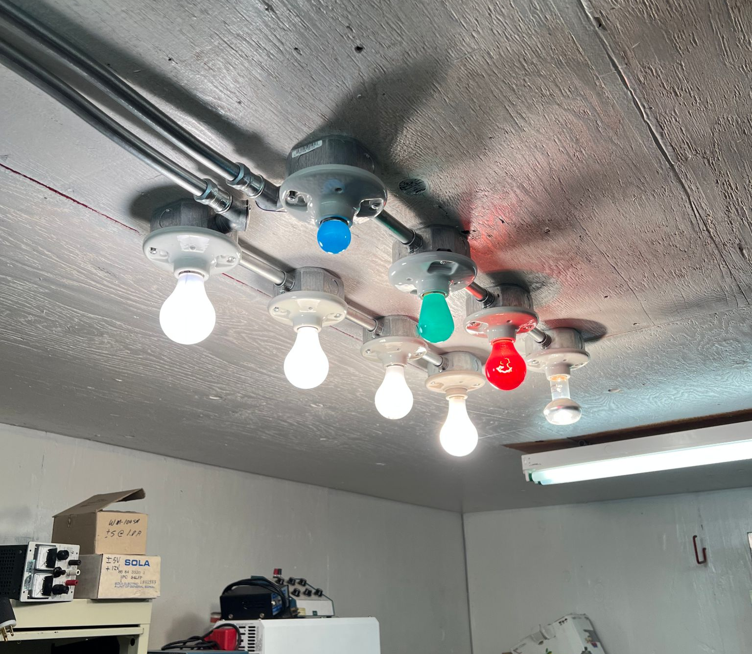
Connecting the Inverter to Power
Figure 9: 20 Amp Breaker
Figure 10: Updated Solar Production Values ( ~ .6 kw)
Figure 11: Prototype Simulated Power Draw Source

Slide 7
Prototyping Issues and Complications
Complications with Radian System and Mode Selection
Unable to pull directly from the grid to power lighting in testing
Suspected wiring issue for AC in/out
Inverter purchase selection has not been made
Inverter is distributor specific, will require similar reading
and research with different makes and models

Slide 8
Prototyping Takeaways
“Hands - on” experience
Greater knowledge of system components and application
Understanding of inverter importance as a system controller
PV system competency
Learning off-site = less time spent on-site
Important for long distance site location

Slide 9
Moving Forward with the Prototype and Full Scale System
Continuing efforts with REL to gain comfort with PV system programming
Planned visits over the summer months to REL and Construction Site
All members will be conducting self-learning over the summer with selected components to gain comfort with installation and troubleshooting
Preliminary assembly of Operation/Assembly Manual for ME 486C

Slide 10
References
[1] “Radian series inverter/charger.” [Online].
Available:https://s3.amazonaws.com/zcom-media/sites/a0i0h00000KyCXiAAN/media/mediamanager/OutBack_Radian_4048A_8048A_Inverter_manual.pdf. [Accessed: 02-May-2023].

